Slide 1
Chapter 3 Practice Test

Slide 2
1.) Describe the transformations from the graph of f(x)=|x|to the graph of the given function. Then graph the function.

Slide 3
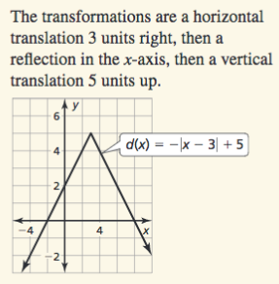

Slide 4
2.) Describe the transformations from the graph of f(x)=|x| to the graph of the given function. Then graph the function.

Slide 5
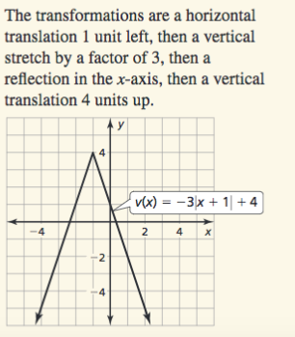

Slide 6
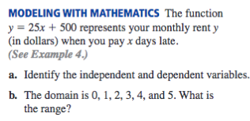
3.)

Slide 8
4.)

Slide 9
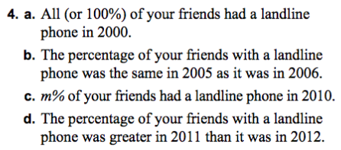

Slide 12
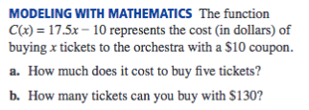
7.)

Slide 14
8.)

Slide 16
9.) Find the value of x so that the function has the given value (there are three separate problems listed below).

Slide 18
10.)

Slide 19
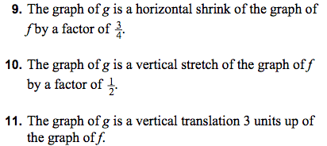

Slide 20
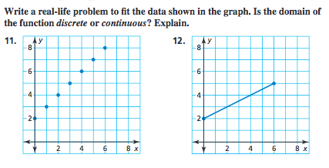

Slide 21
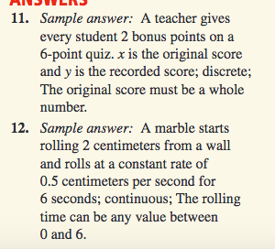

Slide 22
Graph the linear function.

Slide 23
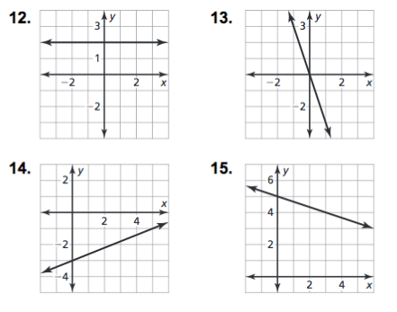

Slide 24
16.) Graph the following equation.

Slide 25
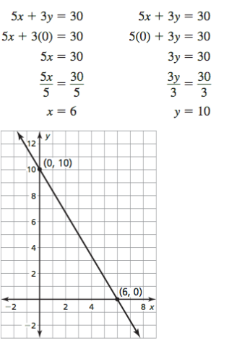

Slide 26
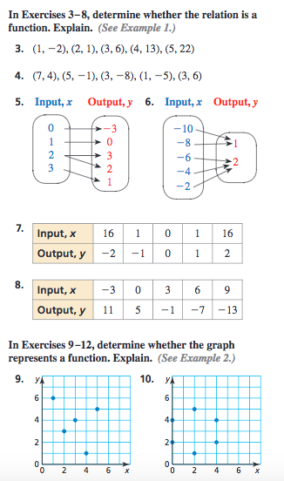
17.)

Slide 27
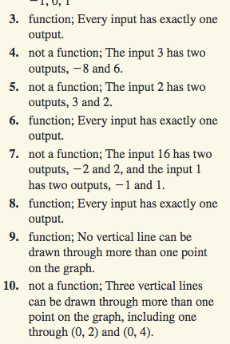

Slide 28
18.)

Slide 29
1.) -3
2.) 12
3.) -2
4.) 8.5

